Slide 1
AIML Premalatha T

Slide 2

WHO AM I?
LinkedIn: https://www.linkedin.com/in/latha-t-k-b21018128/
Data Science ,AIML
Data Analysis ,SQL,Pyspark
Data Visualization ,PowerBI,Tableau
Natural Language Processing (NLP)
Computer Vision
Generative AI,Prompt Engineering
BigData and Data Engineering

Slide 3
Agenda
What is ML,DL and AI
Steps in a ML Project
ML Techniques and Tools
DS Learning Path

Slide 4
Data?
Information and Noise(Insignificant information)
ML ,DS,AI-> Extract information(Exclude noise)

Slide 5
Types of Analytics
In today's data-driven world, information is king. But raw data itself isn't enough.
We need to analyze it to extract insights and make informed decisions

Slide 6
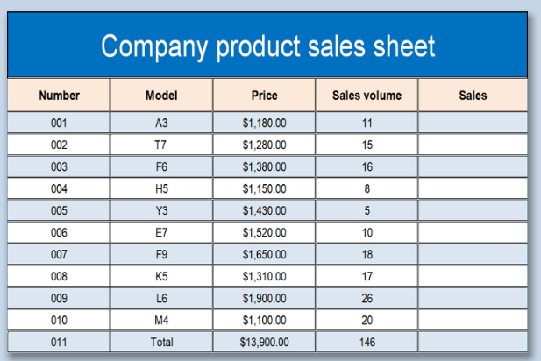
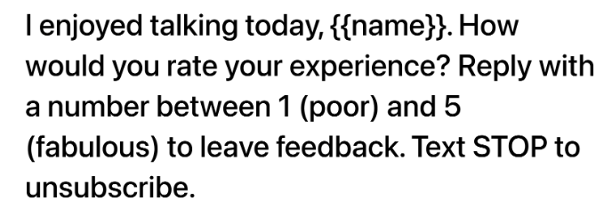

Slide 7
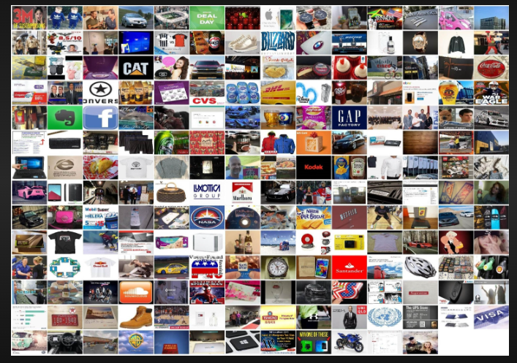
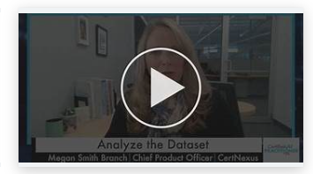
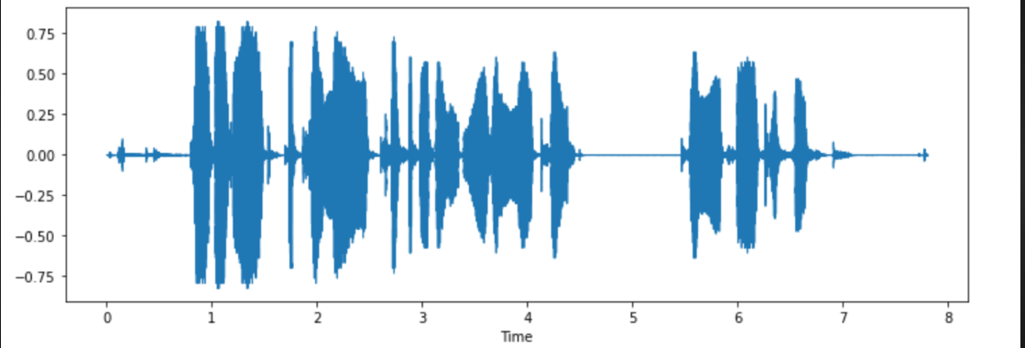

Slide 8






Slide 9
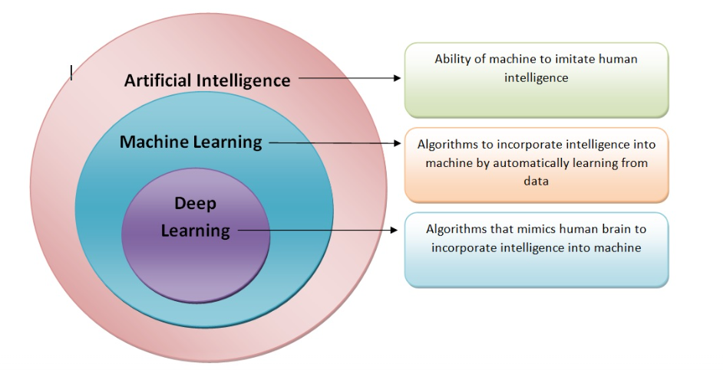

Slide 10
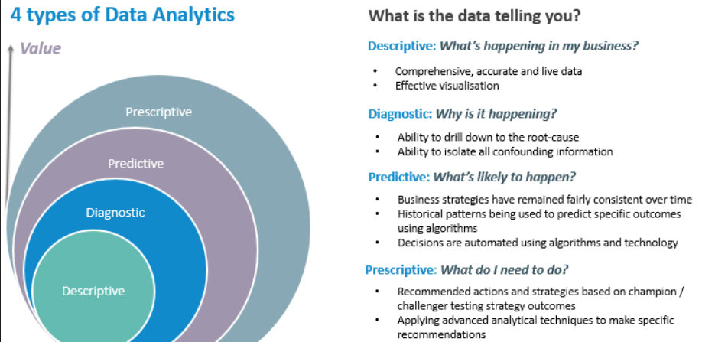

Slide 11
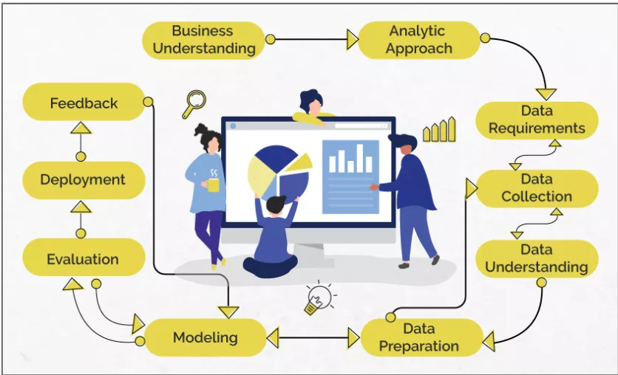
Data Science/Machine Learning

Slide 12
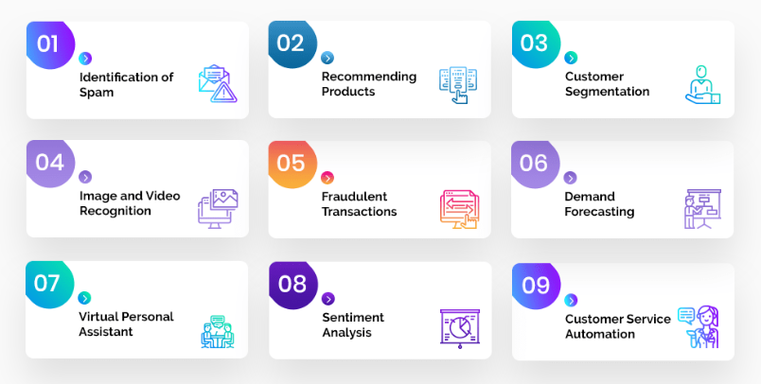
Problem Statement

Slide 13
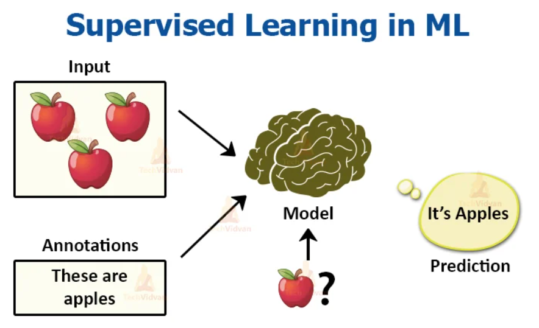
Analytic Approach

Slide 14
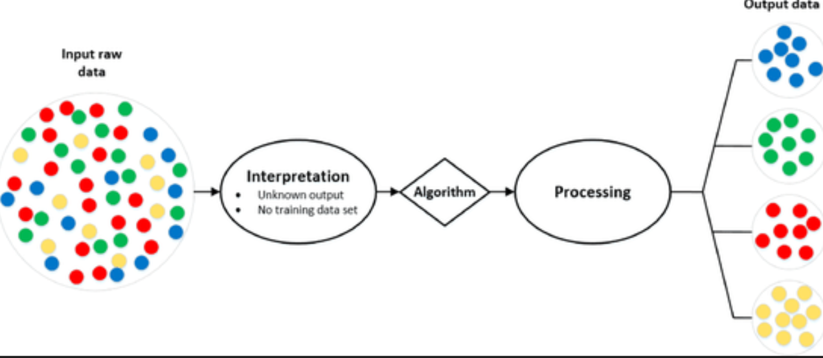
Analytic Approach

Slide 15
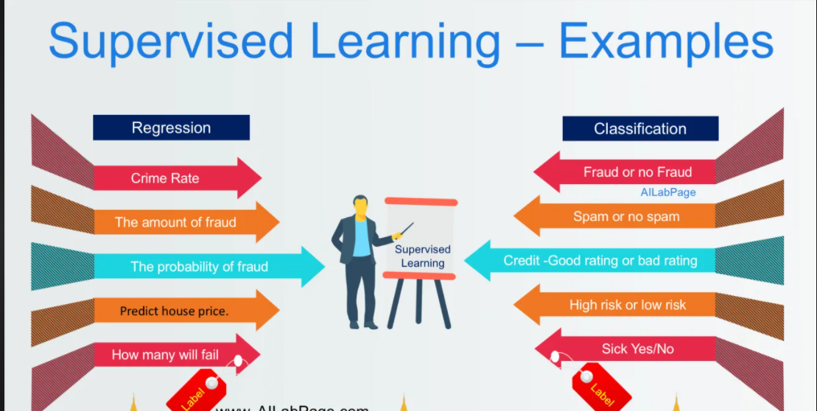
Supervised Learning

Slide 16
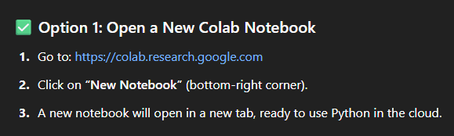

Slide 17
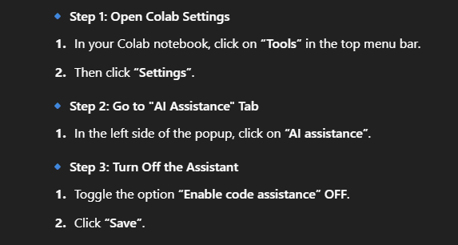

Slide 18
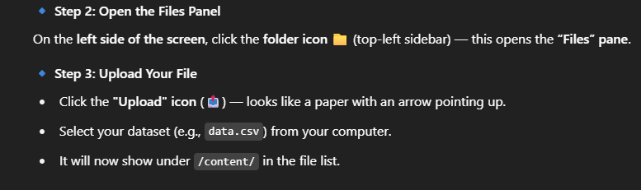

Slide 19
Questions ????

Slide 20
STATISTICS
INTRODUCTION TO STATISTICS

Slide 21
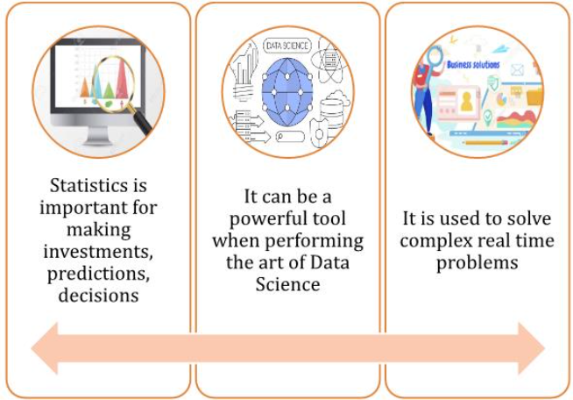

Slide 22
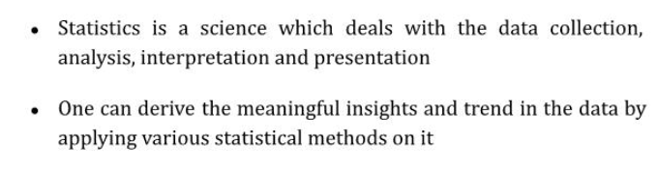

Slide 23
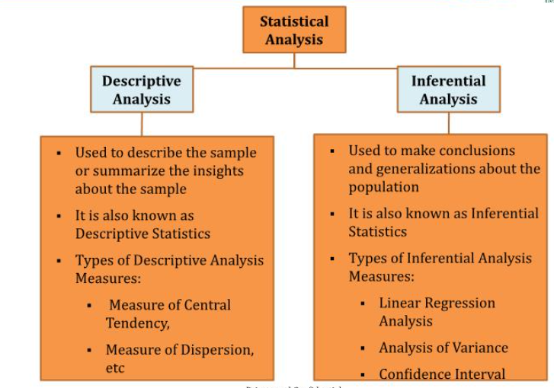

Slide 24
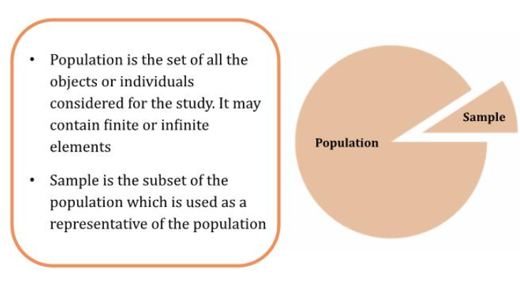
Population and Sample

Slide 25
Descriptive Statistics

Slide 26
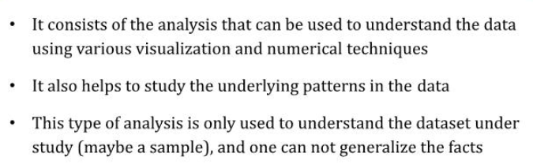

Slide 27
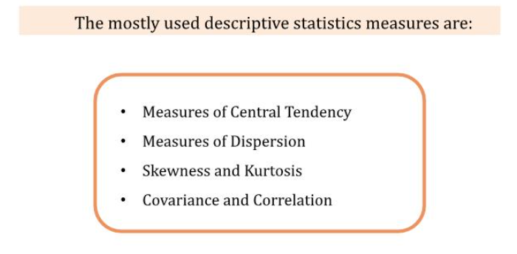

Slide 28
Measures of Central Tendency

Slide 29
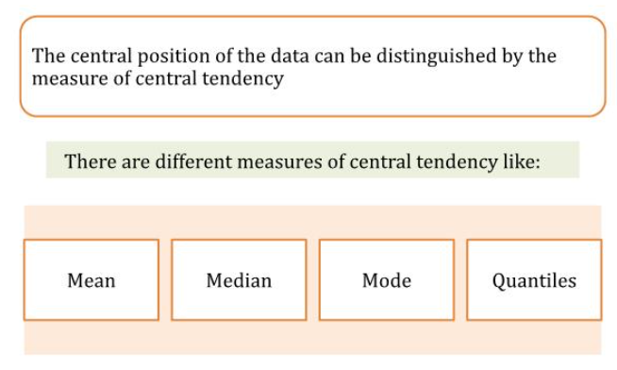

Slide 30
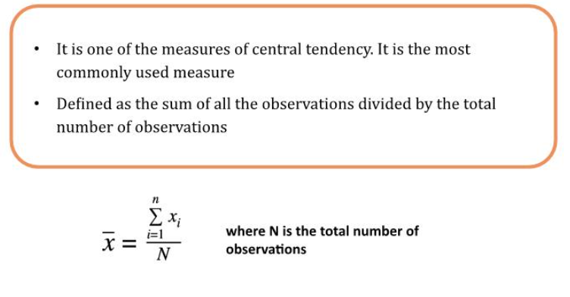
Mean

Slide 31
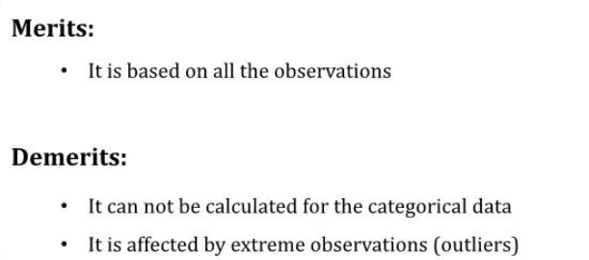

Slide 32
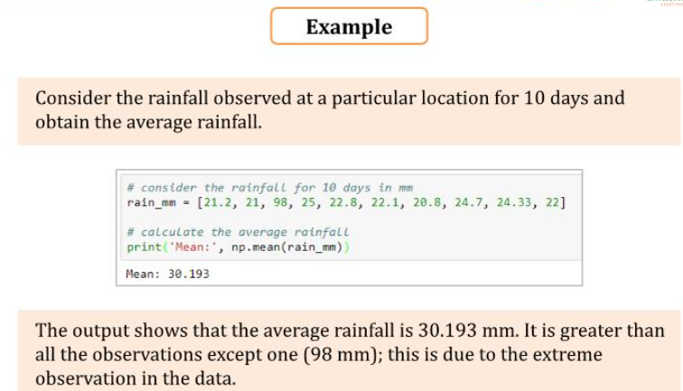

Slide 33
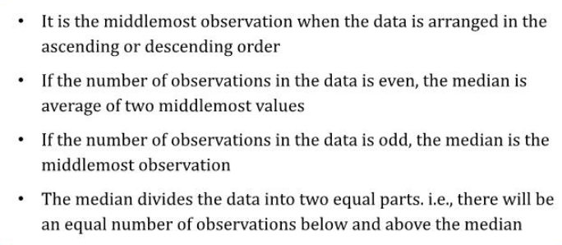
Median

Slide 34
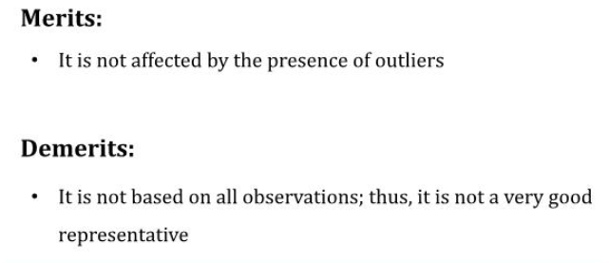

Slide 35
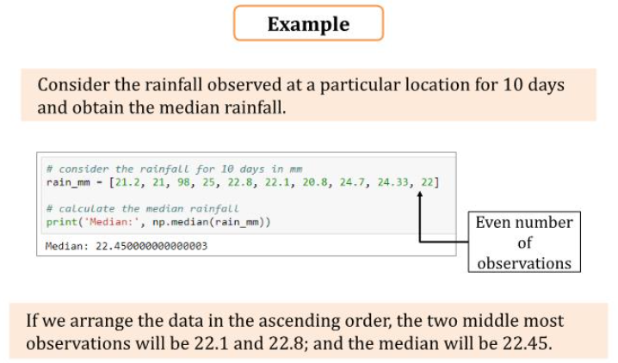

Slide 36
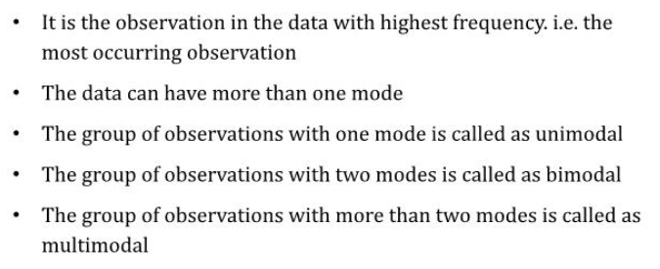
Mode

Slide 37
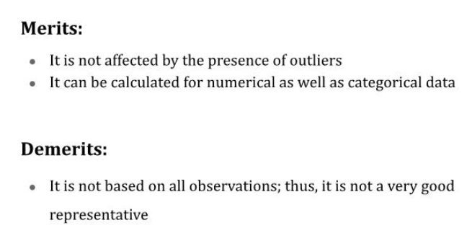

Slide 38
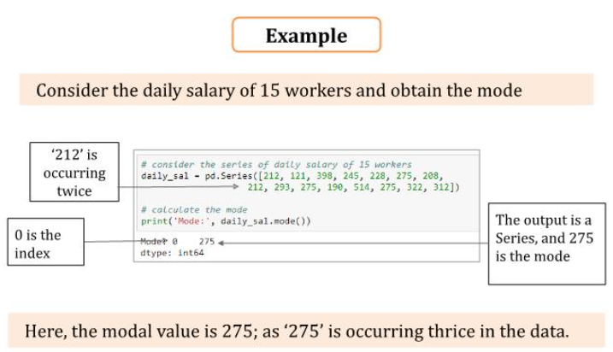

Slide 39
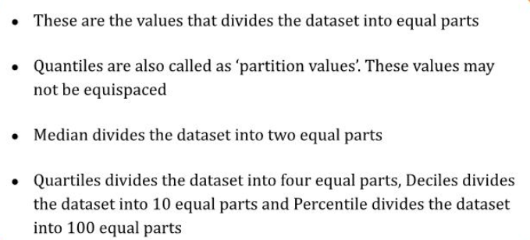
Quantiles

Slide 40
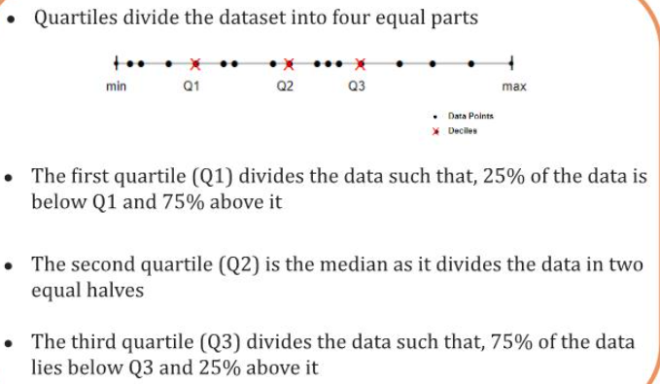

Slide 41
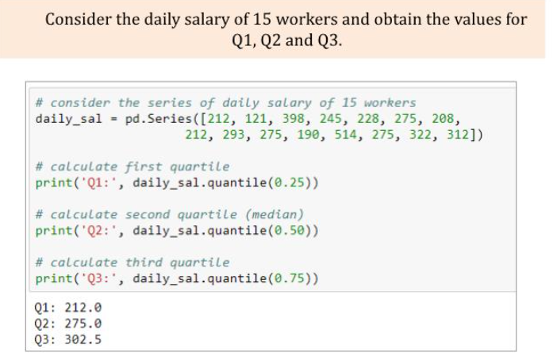

Slide 42
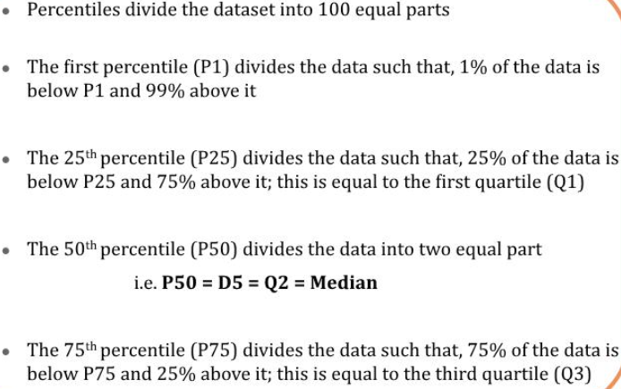
Percentiles

Slide 43
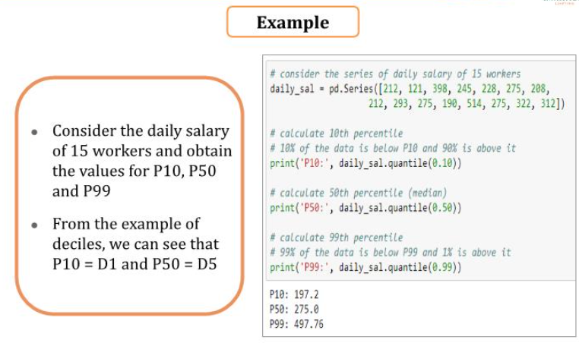

Slide 44
Measures of Dispersion

Slide 45
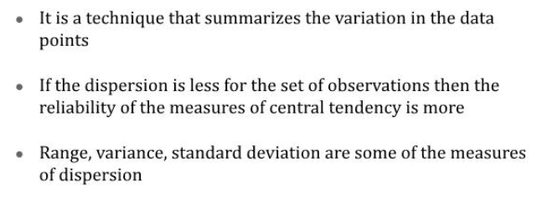

Slide 46
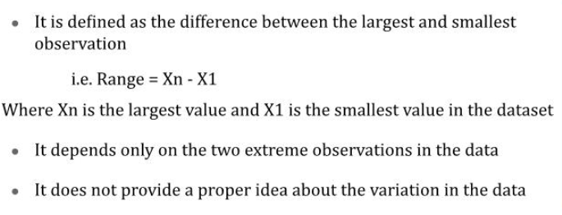
Range

Slide 47
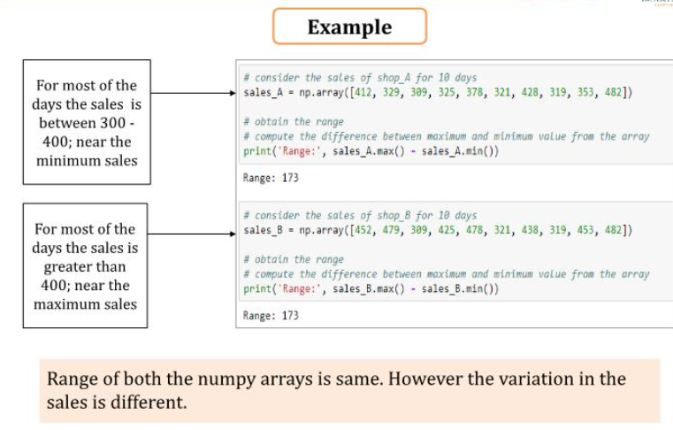

Slide 48
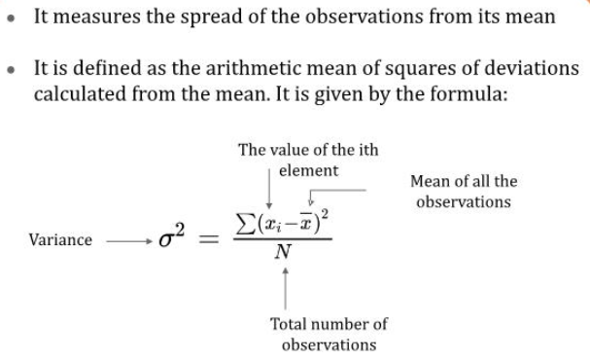
Variance

Slide 49
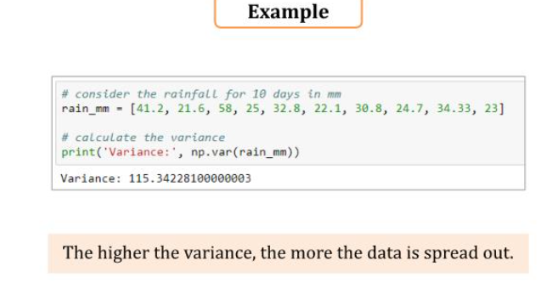

Slide 50
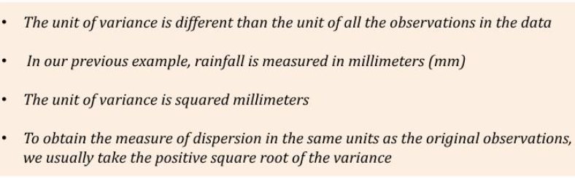

Slide 51
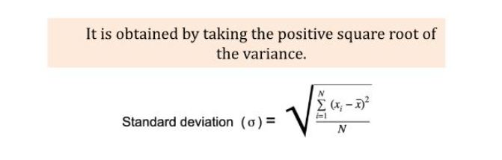
Standard Deviation

Slide 52
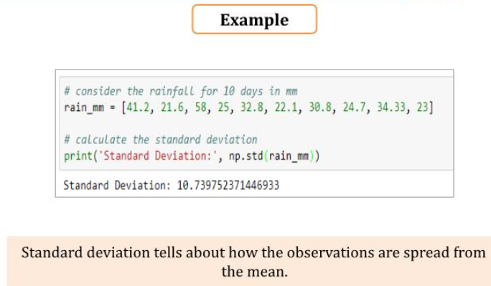

Slide 53
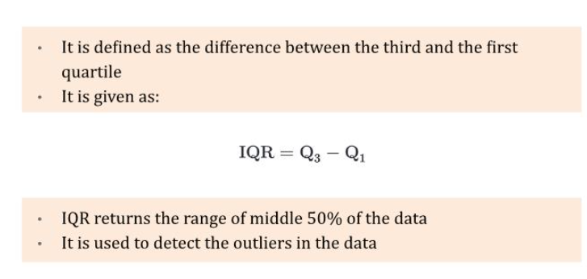
IQR

Slide 54
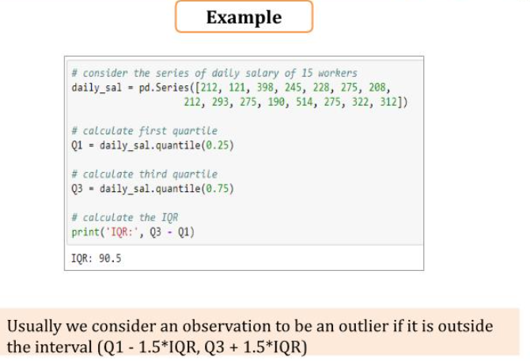

Slide 55
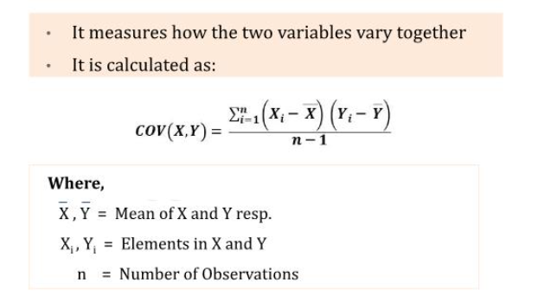

Slide 56
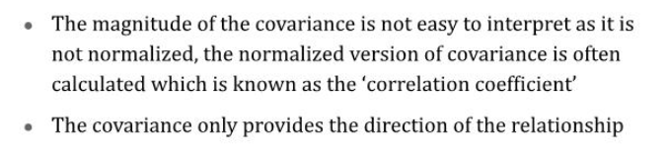

Slide 57
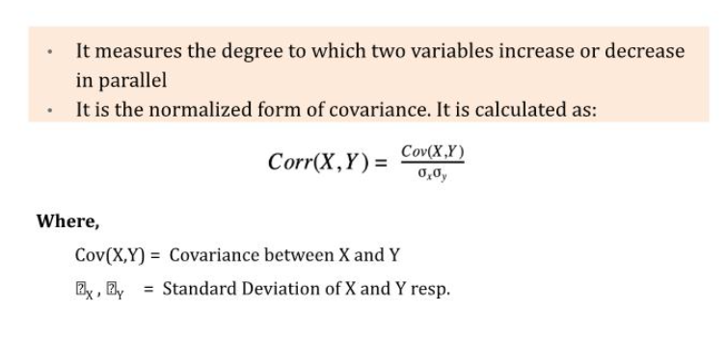

Slide 58
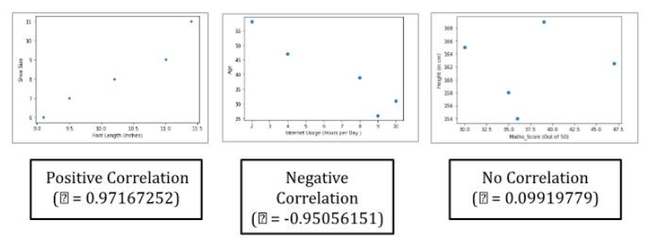

Slide 59


